Slide 1
Romanian Palatalization
An Acoustic Description
Palatalization is a secondary/co-temporal movement of the tongue body.

Slide 2
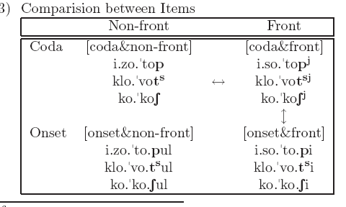

Experiment design
Large disagreement in the literature about whether the palatalized consonants are produced, or are perceivable, particularly on the post-alveolar fricative “esh”
  So Hypothesis 1: Palatalized consonants are significantly different than plain consonants
    Test: Compare between +Coda items
Our claim: there was historically a vowel there [i], which we know became voiceless in the history of Romanian, the null hypothesis is that it is still a voiceless vowel which has been mislabeled as palatalization.
  So Hypothesis 2: Palatalized consonants are not fundamentally different than contextually fronted consonants.
    Test: Compare between +Front items, while controlling for Coda

Slide 3
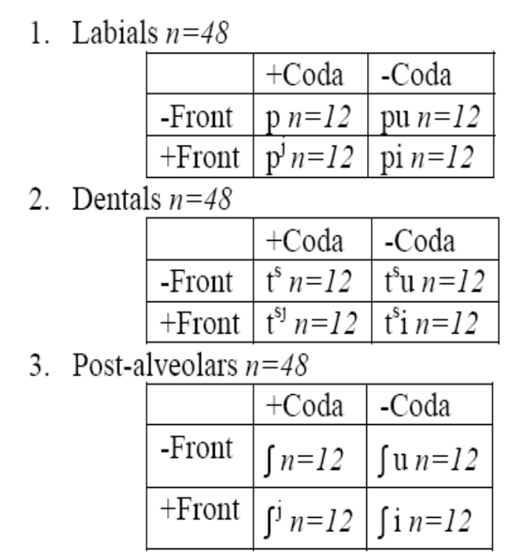
Methods
Recorded 48 tokens of each place of articulation, 12 tokens for each condition
Our experimental units are consonants, not speakers.

Slide 4
Three tests
Duration of the consonant (Line B)
  Expect coda consonants to be longer
    Main effect of coda
  Expect palatalized consonants to be longer (because they contain a voiceless (whispered) [i])
    Interaction between coda and front
Spectral Prominence (Circle A)
  Expect fronted consonants to show a spectral prominence at 2600Hz
F2 in the CV transition (Line C)
  Expect fronted consonants to show a higher F2 than non-front consonants

Slide 5
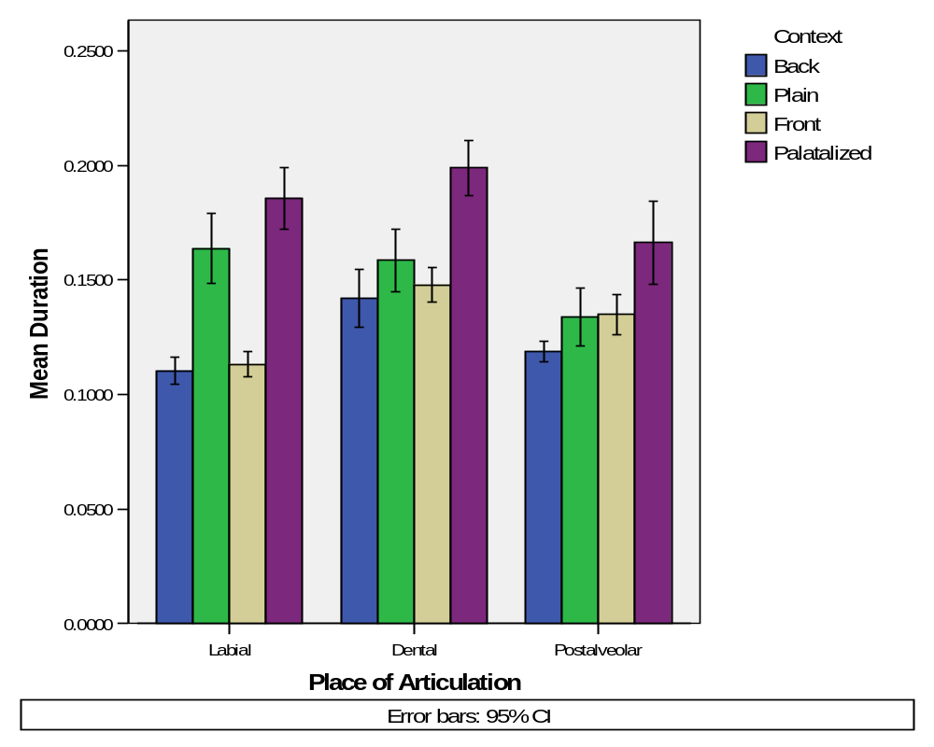
Test 1 - Duration
Exploring the data:

Slide 6
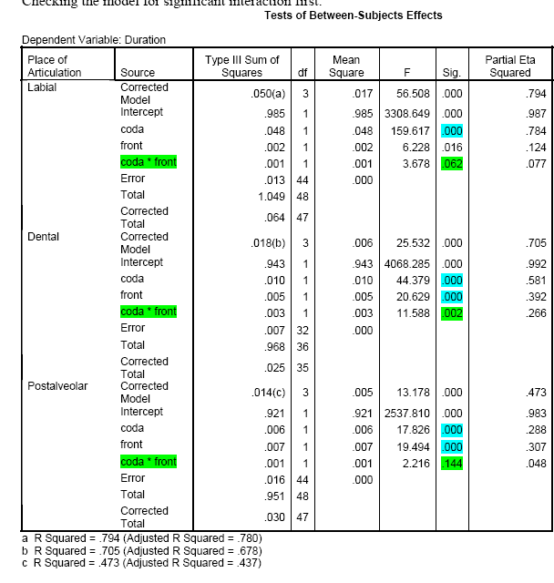
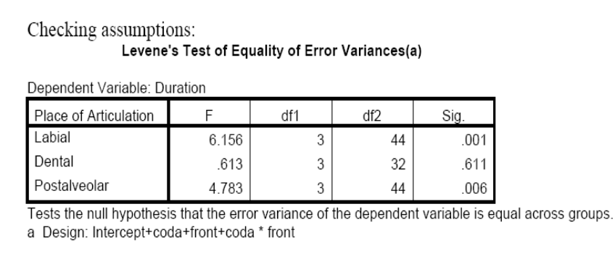
Proposed statistics:
Univariate 2-factor ANOVA to look for an interaction:
Appears to be a significant interaction for Dentals, but not for Labials or Post-alveolars
Main effect of coda and front in Labials
Main effect of coda and front in Post-alveolars

Slide 7
Ways of fixing the unequal variance in labials and postalveolars
Labials had a lot of syllable differences
Postalveoalrs interacted more with the nasal, the nasal was mroe likely to be voiceless maybe.. Probably more vairnte than the otheras anwya as they are fricatives and dont have a on/off ness as much as the labials or dentals do.

Slide 8
Previous accounts
Previous Accounts:
Romanian Palatalization is “phonemic” like Russian, which means it can bear meaning.
  But Romanian palatalization is only found at the end of the word
Romanian Palatalization is “phonological” which means that the speakers intend to produce a second articulation at the same time as the primary articulation.
Our claim:
Romanian Palatalization is “phonetic” which means the palatalization should be to the same degree as other “contextually fronted” consonants. The reason “palatalization” and “contextual fronting” look different is because they are in different syllable positions.

